Slide 1
臨床試驗統計分析
陳慕義
晉加股份有限公司
www.statplusinc.com

Slide 2
循證醫學 Evidence-Based Medicine
循證醫學是謹慎、明確、據判斷力的運用現有最佳證據的醫學。
以客觀臨床科學研究結果為依據，用以決定並應用於個別病人的醫療護理計畫。

Slide 3
What are clinical trials?
FDA
A clinical trial is the clinical investigation of a drug which is administered or dispensed to, or used involving one or more human subjects.
台灣行政院衛生署
藥品施用於病人或健康自願者身上，已發現或驗證其療效，認明其不良反應、研究該藥品在人體的吸收、分布、代謝和排泄過程，以確定其有效性和安全性的系統性研究。

Slide 4
發現新化學物質
實驗室研究
2~3 年
物理化學性狀的研究
毒性試驗與安全性試驗
前臨床試驗階段
(動物試驗)
3~5 年
藥理試驗
IND
第 一 階 段 (Phase I)
人體臨床試驗階段
第 二 階 段 (Phase II)
3~5 年
第 三 階 段 (Phase III)
NDA
新藥審查
2~3 年
第 四 階 段 (Phase IV)
(新藥監視期
新藥上市
3~5 年

Slide 5
Phase I
根據臨床前藥理研究結果，首次在人體（健康）進行研究藥物的周密試驗。
目的是觀察藥物在人體內的作用機制：藥物動力學，藥物在人體內的吸收速率和程度、在體內重要器官的分布和維持情況、代謝、排泄的速率和程度等，和藥效學、耐受性和安全性。

Slide 6
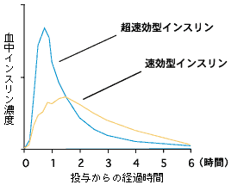
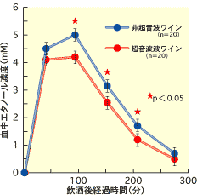

Slide 7
Phase II
適應症確立後，第一批病人接受研究藥物。
觀察最大耐受劑量以下的劑量範圍，找出具最佳療效、沒有或可接受的副作用的相應劑量範圍，進而訂定最佳劑量，以及評價效果。
考慮治療可行性。

Slide 9
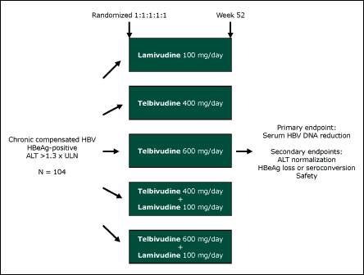

Slide 10
Phase III
基於前期研究結果，以確定研究藥物的有效性和安全性、受益和危害比率。
需選擇需要接受治療的病人，以確定臨床效用。受試者包括特殊群（如老年人），以觀察普遍耐受性。

Slide 12
Phase IV
新藥獲准註冊上市後的大型研究，監察普遍臨床使用時的不良反應和毒性。
研究目的為進一步了解安全性和療效等的詳細資料、收集長期安全性數據、其他未被發現的適應症等等。
流行病學研究：提供經濟上的間接影響信息，幫助地方醫療管理人員制訂醫療政策，更有效分配資源。

Slide 13
International Conference on Harmonization (ICH)
International Conference on Harmonization of Technical Requirements for the Registration of Pharmaceuticals for Human Use
緣由：各國臨床研究規範發展不同，實施時間有別，原則雖相同，但具體內容細節則有別，以致新藥上市申請要分別在每一國家按當地法規，重複進行各類試驗和研究，耗費時間、人力、物力，結果是增長新藥上市申請時間、延遲病人獲得新藥治療的機會，總樣本數大增，及暴露於臨床研究潛在危害的人數增加，以上均是不道德行為。因此全球三個製藥最發達地區（美國、日本、歐洲）於1990年4月在比利時布魯塞爾成立ICH，之後每兩年開會一次，直至完成制定或全球認定的統一規範。

Slide 14
ICH組織結構
組織成員：美國、日本、歐洲
程序委員會
管理機構：
美國（FDA食品藥物管理局）
日本（JMHW厚生省）
歐洲（EMEA歐洲藥品評審委員會）
工業機構：
美國（PhRMA美國製藥生產研發協會）
日本（JPMA日本製藥工業協會）
歐洲（EFPIA歐盟製藥工業協會）
觀察機構
世界衛生組織（WHO）
加拿大（CHPB）
歐洲（EFTA）

Slide 15
ICH工作進程
ICH 1：1991/11（比利時布魯塞爾）
ICH 2：1993/10（美國奧蘭多）
ICH 3：1995/11（日本橫濱）
ICH 4：1997/7（比利時布魯塞爾）
ICH 5：2000/11（美國聖地牙哥）
ICH 6：2003/11（日本大阪）

Slide 16
ICH 制定規範
Q: “Quality”
Chemical and Pharmaceutical Quality Assurance
安定性試驗
S: “Safety”
In vitro and in vivo pre-clinical studies
E: “Efficacy”
Clinical studies in human subject
E6 – GCP
E8 – General considerations for clinical trials
E9 – Statistical principles for clinical trials
M: “Multidisciplinary”
Not fit uniquely into one of the above categories

Slide 17
Contract Research Organization CRO
受託研究機構
指一個商業性或學術性的研究機構，試驗委託者可將某些工作和職責轉移至該機構。
工作範圍包括臨床研究中的研究方案設計和編寫、研究執行和管理、監測、資料數據處理、統計學分析、總結報告、稽查、規章制度的提交和其他服務。

Slide 18
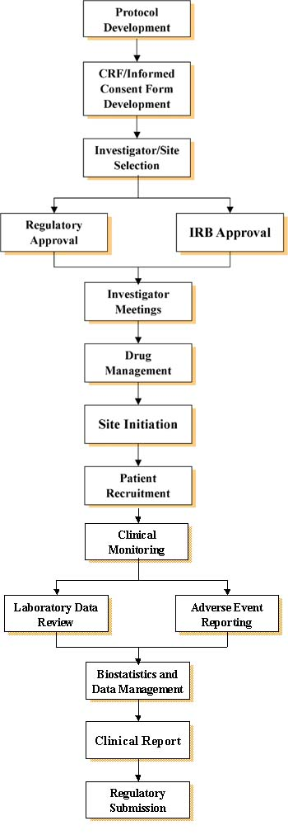

Slide 19
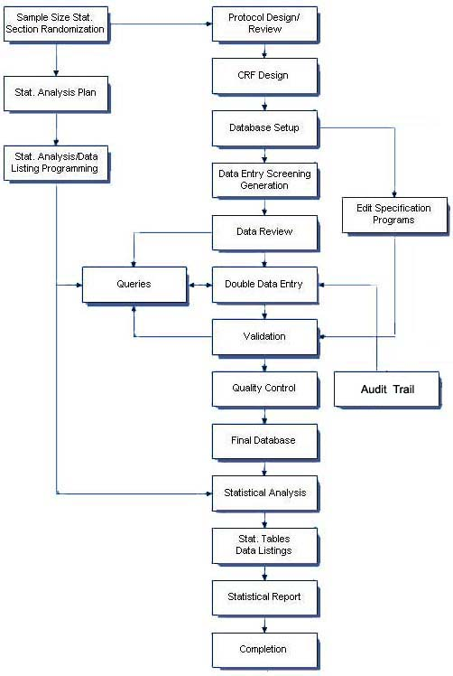

Slide 20
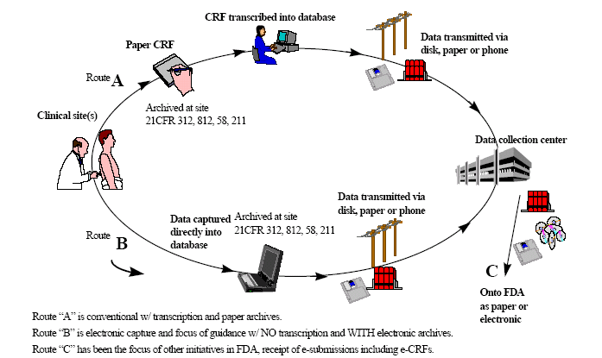
Paper CRF、e-CRF

Slide 21
Basic Principle on Clinical Trial Design
Objective
To obtain an unbiased and reliable assessment of given regimen response, independent of any known or unknown prognostic factors.
Principle
Allocation at random | Representative
Blinding | Reliability
Control group | Reproducibility

Slide 22
Allocation at Random
Tends to produce treatment groups in which the distributions of prognostic factors are similar
Stratification
If there are known factors that could affect the outcome (center, age, sex, baseline risk)
Only one or few factors used for stratification
Block
Block size divisible by number of treatment
Block size of two is not used

Slide 23
Simpson’s Paradox
 | Success | Regimen A | Regimen B
Overall | Yes | 289 (83%) | 273 (78%)
 | No | 61 (17%) | 77 (22%)
Group 1 | Yes | 234 (83%) | 81 (93%)
(Male) | No | 36 (17%) | 6 (7%)
Group 2 | Yes | 55 (69%) | 192 (73%)
(Female) | No | 25 (31%) | 71 (27%)

Slide 24
Permuted-Block Randomization
Random Allocation within each block
1,2,3,4
By Random Selection of Blocks
TTPP
PPTT
TPTP
TPPT
PTPT
PTTP

Slide 25
Blinding
To limit the occurrence of conscious and unconscious bias in the conduct and interpretation of a clinical trial
Open
Single Blind
Double Blind
To maintain the blind a control must look, smell, taste and feel the same as the comparator of interest, whether the treatment is a placebo or an active control – maybe with double dummy.

Slide 26
Double Dummy
Occasions
No matching placebo available
Different frequencies
Example

Slide 27
Control Groups
Placebo control
U.S. FDA (most desirable)
Other countries (less acceptable)
Unethical (sometime)
Active comparator control
Established, standard treatment used for the condition
Three treatment group (placebo & active)
Historical control
Cancer trial
No control (observational study)

Slide 28
Representative
The primary variable (“target” variable, primary endpoint) should be the variable capable of providing the most clinically relevant and convincing evidence directly related to the primary objective of the trial. – ICH E9

Slide 29
Reliability
If any of the efficacy or safety assessments was not standard, i.e., widely used and generally recognized are reliable, accurate and relevant (able to discriminate between effective and ineffective agents), its reliability, accuracy and relevance should be documented. It may be helpful to describe alternatives considered but rejected. – ICH E3

Slide 30
Reproducibility
If the outcome is to be recorded on different sessions then one should know the repeatability of the measure so one can appropriately quantify any longitudinal treatment effect.

Slide 31
Three Key Components
Experimental unit
A subject from a targeted population under study
Treatment
It could be a placebo or any combinations of (pharmaceutical entity, diet, surgical procedure, diagnostic test, medical device, no treatment)
Evaluation
Efficacy analysis (Clinical endpoints)
Safety assessment (Adverse experience, Laboratory test results)
Others (Quality of life assessment, Pharmacoeconomics and outcomes research)

Slide 32
Adequate and Well-controlled Study
Objective (clear)
Methods of analysis (appropriate statistical methods)
Design (valid for addressing scientific questions)
Selection of subjects (assurance of the disease under study)
Assignment of subjects (minimize bias)
Participants of studies (minimize bias)
Assessment of responses (well-defined and reliable)
Assessment of the effect (accurate and reliable)

Slide 33
Key Statistical Concepts
Bias and Variability
Hypothesis Testing
Type I Error and Power
Confounding and Interaction
Statistical Difference vs Clinical Difference
Sample Size

Slide 34
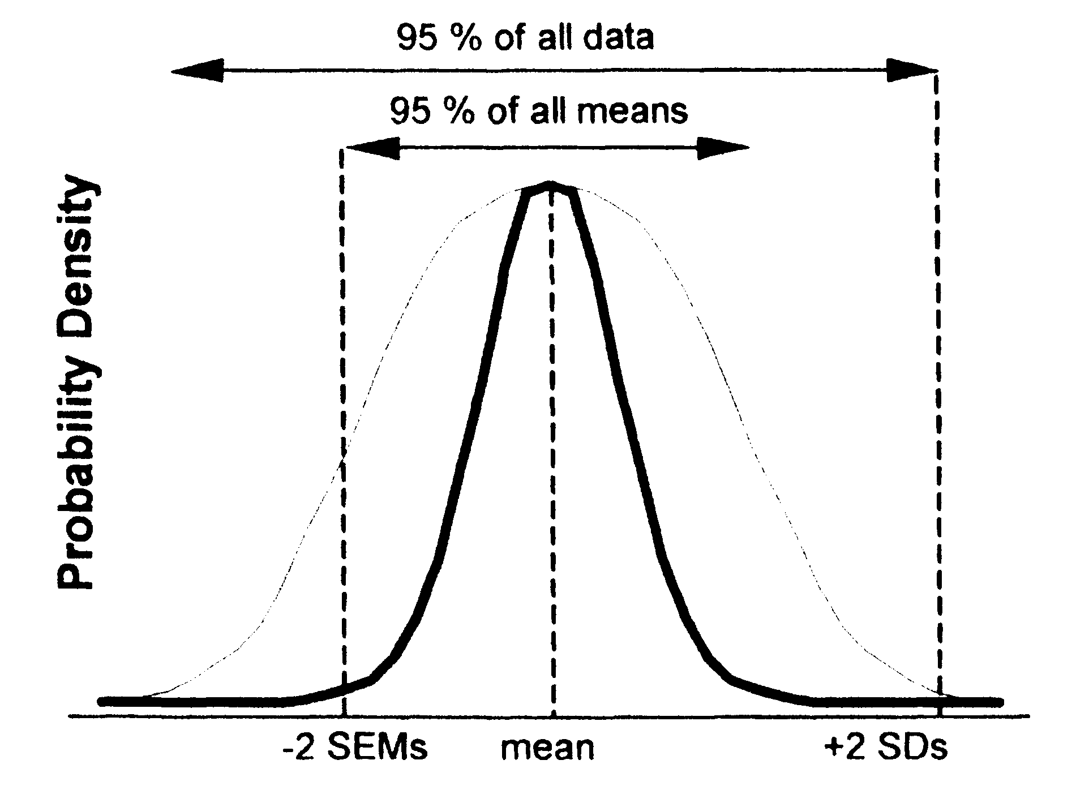

Slide 35
Bias
An inclination or preference that interferes with impartial judgment (Webster’s Dictionary, 1984)
A systematic error that enters a clinical trial and distorted the data obtained as opposed to a random error (Spilker, 1991)
It measures the closeness of the test result to the true value (e.g., population mean)
Accuracy

Slide 36
Variability
A measure of precision or reliability that is referred to as the degree of closeness of clinical results to the true value regarding the targeted patient population
The higher precision, the more likely the result can be reproduced
Precision

Slide 37
Bias and Variability
Less bias, small variability Large bias, small variability
Less bias, large variability Large bias, large variability

Slide 38
Bias and Variability
It is not possible to avoid bias and variability in real world.
It is important to
identify,
eliminate, and
control
the bias/variability to an acceptable limit.

Slide 39
Step on Performing Hypotheses Testing
Choose the null hypothesis that is to be questioned.
Choose an alternative hypothesis that is of particular interest to the investigators.
Select a test statistic, and define the rejection region (or a rule) for decision making about when to reject the null hypothesis and when not to reject it.
Draw a random sample by conducting a clinical trial.
Calculate the test statistic and its corresponding p-value.
Make conclusion according to the predetermined rule.

Slide 40
Type of Hypotheses Testing
Test for Equivalence
Test for Non-inferiority
Test for Superiority
Clinical
Statistical

Slide 41
Test for Equivalence
Purpose
To show that the test drug can reach the same therapeutic effect as that of a standard therapy (or an active agent) or they are therapeutically equivalent

Slide 42
Test for Equivalence
Hypothesis
Null hypothesis: There is a clinically meaningful difference between the test drug and the standard therapy
Alternative hypothesis: There is no clinically meaningful difference between the test drug and the standard therapy
The rejection of the null hypothesis suggests that there is no clinically meaningful difference between the test drug and the standard therapy and hence we conclude that the test drug is equivalent to the standard therapy.

Slide 43
Test for Non-inferiority
Purpose
To show that the test drug is no worse than a standard therapy or an active agent
Situations where it is applicable
The test drug is less toxic
The test drug is easier to administer
The test drug is less expensive

Slide 44
Test for Non-inferiority
Hypothesis
Null hypothesis: The test drug is inferior to the standard therapy
Alternative hypothesis: The test drug is not inferior to the standard therapy
The concept is to reject the null hypothesis and conclude that the difference between the test drug and the standard therapy is less than a clinically meaningful difference and hence the test drug is no worse than the standard therapy.

Slide 45
Test for Superiority
Purpose
To show that the test drug is superior to a standard therapy or an active agent

Slide 46
Test for Superiority
Hypothesis (Statistically -> Clinically)
Null hypothesis: There is no clinically meaningful difference between the test drug and the standard therapy
Alternative hypothesis: The test drug is superior to
the standard therapy
The rejection of the null hypothesis suggests that the difference between the test drug and the standard therapy is greater than a clinically meaningful difference and hence we conclude that the test drug is superior to the standard therapy.

Slide 47
Relationship Among Non-inferiority, Superiority, and Equivalence
µ
-
δ
µ
µ
+
δ
s
s
s
[
]
|
|
←
Equivalence
→
|
There is no clinically significantly meaningful
difference between the test drug and the standard
therapy. It is usually referred to as
two
-
sided
equivalence
.

Slide 48
Relationship Among Non-inferiority, Superiority, and Equivalence
µ
-
δ
µ
µ
+
δ
s
s
s
[
]
|
Inferiority
→
|
←
Non
-
inferiority
Non
-
inferiority = at least as effective as
…
It is also referred to as
one
-
sided equivalence

Slide 49
Relationship Among Non-inferiority, Superiority, and Equivalence
µ
-
δ
µ
µ
+
δ
s
s
s
[
]
|
Non
-
superiority
→
|
←
Superiority
Non
-
superiority = at most as effective as
…
It is also referred to as
one
-
sided equivalence

Slide 50
Relationship Among Non-inferiority, Superiority, and Equivalence
µ
-
δ
µ
µ
+
δ
s
s
s
[
]
|
Inferiority
→
|
←
Equivalence
→
|
←
Superiority
|
←
Non
-
inferiority
Non
-
superiority
→
|
One
-
sided Equivalence

Slide 51
Relationship Among Non-inferiority, Superiority, and Equivalence
µ
δ
δ
-
µ
µ
+
s
s
s
[
]
|
Inferiority
→
←
→
←
|
Equivalence
|
Superiority
H
:
µ
-
≤
δ
≥
δ
≤
δ
µ
-
H
: |
µ
-
µ
|
H
:
µ
-
µ
0
T
s
0
T
s
0
T
s
H
:
µ
-
δ
δ
δ
µ
>
-
H
: |
µ
-
µ
|
<
H
:
µ
-
µ
>
a
T
s
a
T
s
a
T
s
Would like to reject the null hypothesis and conclude the
alternative hypothesis

Slide 52
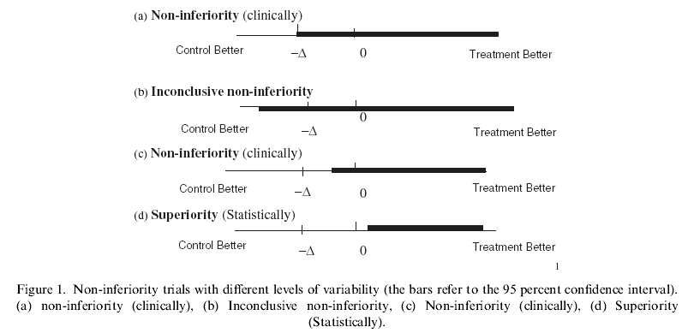
Relationship Among Non-inferiority, Superiority, and Equivalence

Slide 53
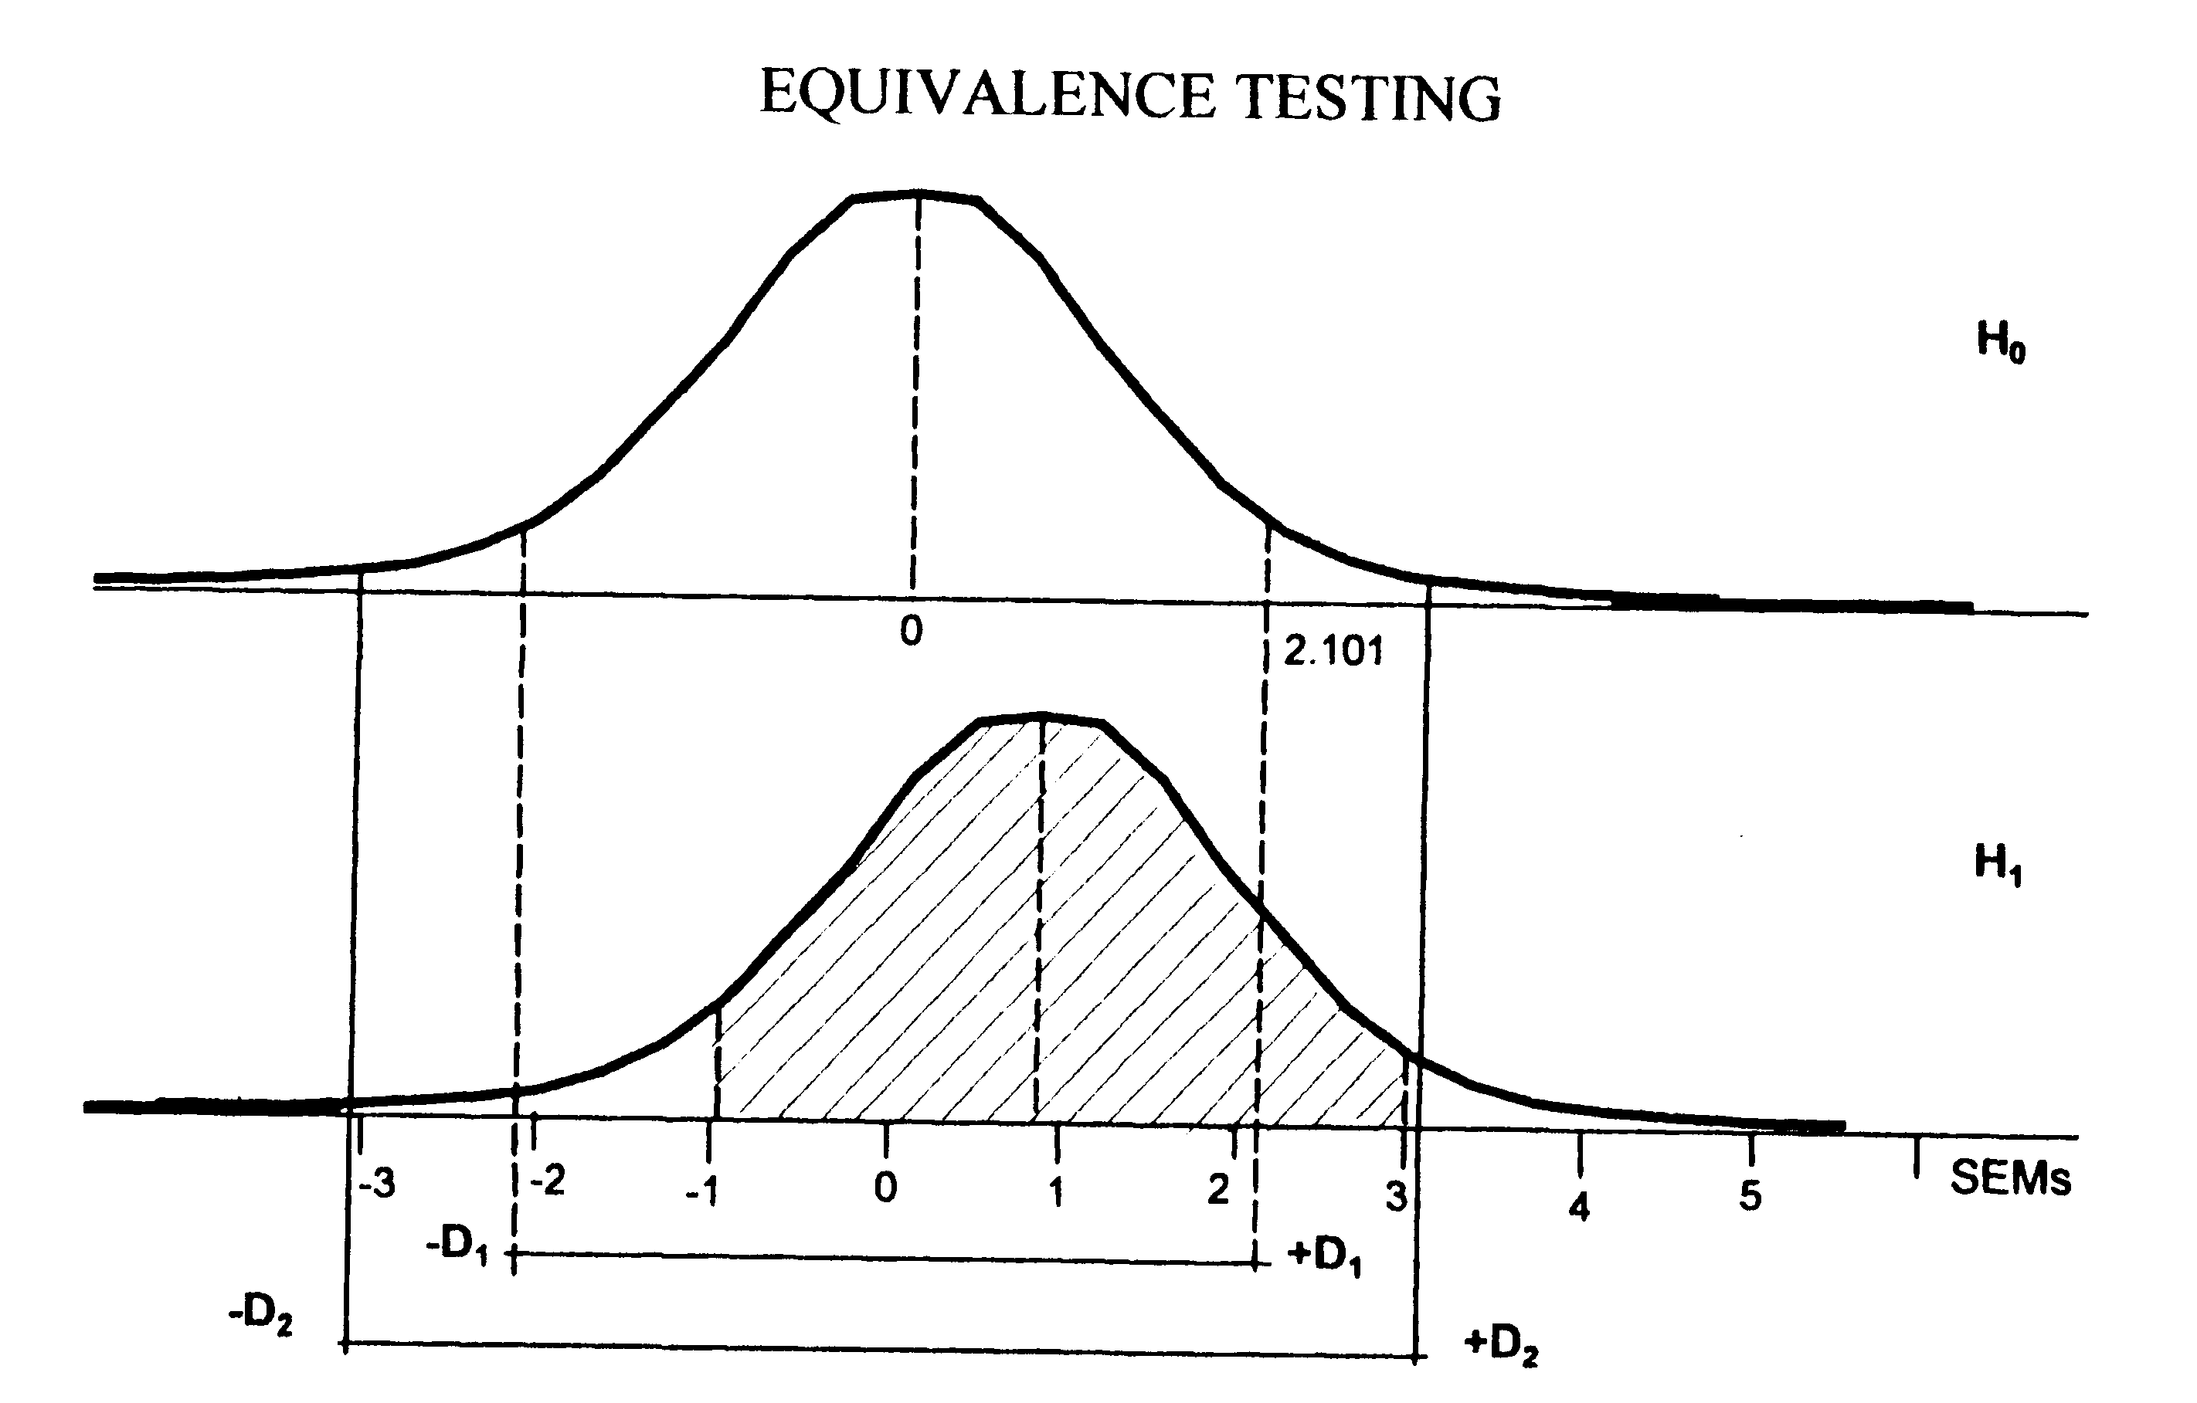
Equivalence Margin

Slide 54
Type I Error and Power
Null hypothesis: The drug is ineffective
Alternative hypothesis: The drug is effective
Type I error : the drug works when in fact it doesn’t.
Type II error : the drug doesn’t work when in fact it does.
P-value : the probability of observing a type I error.
Power : the probability of correctly concluding that the drug
works when in fact it does.

Slide 55
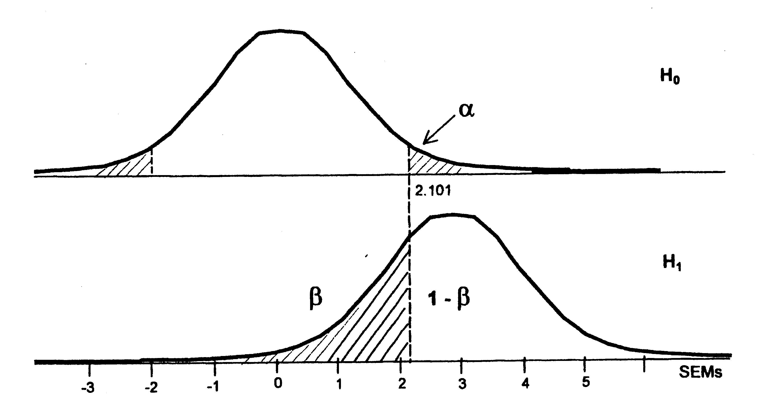
Type I Error and Power

Slide 56
Type I Error and Power
Decrease type I error will result in increasing type II error, and consequently decreasing power.
Increase sample size will decrease both type I and type II errors.
Fixed type I error and select a sample size to achieve the desired power.

Slide 57
Confounding and Interaction
Confounding
Confounding effects are defined as effects which are contributed by various factors that cannot be separated by the design under study.
Interaction
The interaction effect between factors is defined as the joint effect contributed by more than one factor.

Slide 58
Confounding
Lab Example
Dr. Anderson noticed that recent laboratory test results failed to pass QC/QA requirements
Dr. Anderson decided to improve the laboratory procedure by purchasing a more advanced equipment
The accuracy and precision of the laboratory test results improve significantly and meet the QC/QA
Question
It is not clear whether the improvement in laboratory test results is due to the advanced new equipment or due to the analyst who has more experience than the previous analyst.

Slide 59
Interaction
Quantitative interaction
Quantitative interaction between treatment and center (or study site) indicates that the treatment differences are in the same direction across centers but the magnitude differs from center to center.
Qualitative interaction
Substantial treatment differences occur in different directions in different centers.

Slide 60
Center-by-Treatment Interaction
Treatment
Treatment
Control
Control
Center 1
Center 2
Quantitative interaction - centers could be combined.

Slide 61
Center-by-Treatment Interaction
Drug A
Drug B
Drug A
Drug B
Center 1
Center 2
Qualitative interaction - centers cannot be combined.

Slide 62
Confounding and Interaction
Study design should avoid or be able to account for potential
Confounding factors
Interaction factors
Objectives
To provide a valid and fair assessment of the treatment effect
To assess the treatment difference efficiently

Slide 63
Impact on Center Imbalance
Coefficient of Imbalance (λ)
Drug Information Journal. Vol. 38 pp. 387-394, 2004
At α=0.05
λ | Power (90%) | Power (80%) | λ | Power (90%) | Power (80%)
1 | 90% | 80% | 0.5 | 63% | 50%
0.9 | 86% | 75% | 0.4 | 53% | 42%
0.8 | 82% | 70% | 0.3 | 42% | 33%
0.7 | 77% | 64% | 0.2 | 30% | 23%
0.6 | 70% | 58% | 0.1 | 17% | 14%

Slide 64
Example of Center Imbalance
Source | Sample Size | No. of Country | 1-α/2 | 1-β | λ | Adjusted Power
Trial I | 885 | 29 | 0.95 | 0.8 | 0.90739 | 0.761
Trial II | 143 | 9 | 0.95 | 0.8 | 0.45696 | 0.474
Trial III | 518 | 25 | 0.95 | 0.8 | 0.86231 | 0.739

Slide 65
No. of Centers and Size of Center
Balance in each center
Number of patients in each centers
The number of patients in each center should not be less than the number of centers

Slide 66
Statistical Difference vs. Scientific Difference
Clinical Scientists & Researchers
The observed difference is of clinical meaning and yet not statistically significance (You must be out of your mind!)
The observed difference is of little clinical meaning but it is statistically significant (Who cares?)
Statisticians
P-value must be less than 0.05 in order to have statistical meaning

Slide 67
Statistical Difference vs. Scientific Difference
Statistical difference
A difference which is unlikely to occur by chance alone.
Clinical/Scientific difference
A difference which is considered important to the clinical scientists.

Slide 68
Statistical Difference vs. Scientific Difference
Statistical difference
Clinical
difference
* May be due to large variability and/or small sample size

Slide 69
Sample Size Determination Information Required
Study objectives
Test for equivalence
Test for non-inferiority
Test for superiority (clinically/statistically)
Study design
Parallel or crossover
Group sequential design
Other designs
Primary study endpoint(s)
Continuous or discrete
Multiple study endpoints

Slide 70
Sample Size Determination Information Required
Clinically meaningful difference
Clinically important difference
Non-inferiority/superiority margin
Equivalence/similarity limit
Significance level
1% or 5%
Desired power
80% or 90%
Other information, e.g.,
Stratification?
1:1 ratio or 2:1 ratio?
Log-transformation?

Slide 71
Parallel Design – Equivalence
Hypotheses
: Population mean of the treatment
: Population mean of the control
: Equivalence limit.

Slide 72
Parallel Design – Equivalence
Two one-sided test procedure (Schuirmann, 1987)
Test statistics
Reject the null hypothesis if

Slide 73
Parallel Design – Equivalence
Power

Slide 74
Parallel Design – Equivalence
Sample size calculation

Slide 75
Classification of Statistical Tests
Category
Treatment
Chi-square (PROC FREQ)
Fisher’s exact test (PROC FREQ)
Treatment + Others
CMH with table score (PROC FREQ)
CMH with rank score (PROC FREQ)
Logistic Regression (PROC LOGISTIC/ PROC CATMOD)

Slide 76
Classification of Statistical Tests
Quantitative
Treatment
Unpaired t test (PROC TTEST)
Wilcoxon rank-sum test (PROC NPAR1WAY)
Treatment + Others
GLM (PROC GLM)
GLM with rank-transformed (PROC RANK + PROC GLM)

Slide 77
Classification of Statistical Tests
Survival
Chi-square (PROC LIFEREG)
Log-rank test (PROC LIFETEST)
Cox proportional hazards model (PROC PHREG)

Slide 78
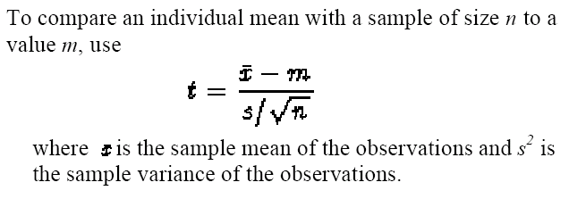
The t test

Slide 79
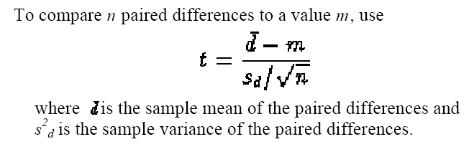
The t test

Slide 80
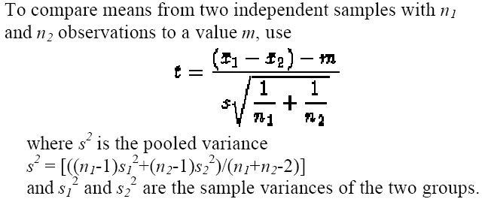
The t test

Slide 81
Example
A treatment is being examined to determine its effect on systolic blood pressure.
Twelve men participate in the study.
Their systolic blood pressure is measured both before and after the treatment is applied.

Slide 82
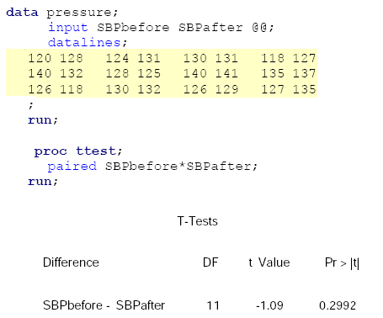
Results

Slide 83
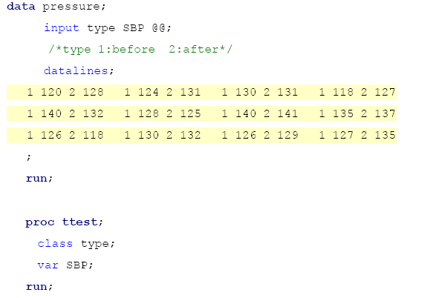
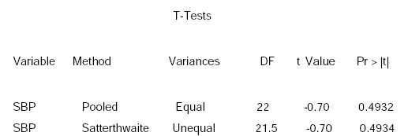
Result

Slide 84
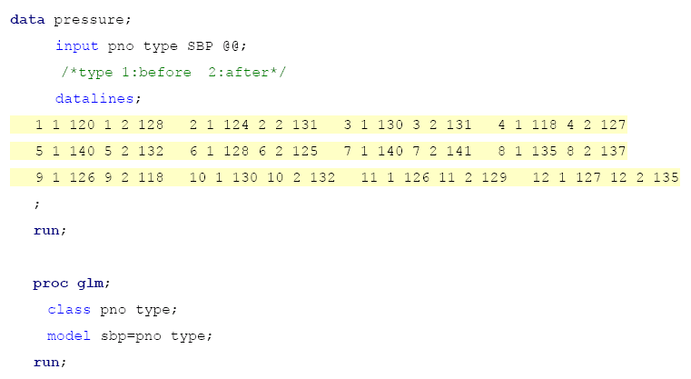
Result

Slide 85
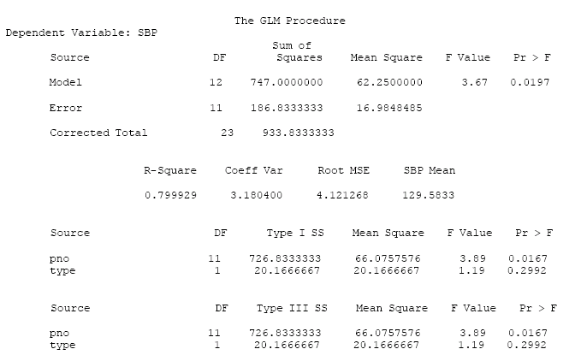
Result

Slide 86
ANCOVA
Analysis of covariance combines some of the features of both regression and analysis of variance. Typically, a continuous variable (the covariate) is introduced into the model of an analysis-of-variance experiment.
Example
Ten patients are selected for each treatment (Drug A or D), and six sites on each patient are measured for leprosy bacilli.
The covariate (a pretreatment score) is included in the model for increased precision in determining the effect of drug treatments on the posttreatment count of bacilli.

Slide 87
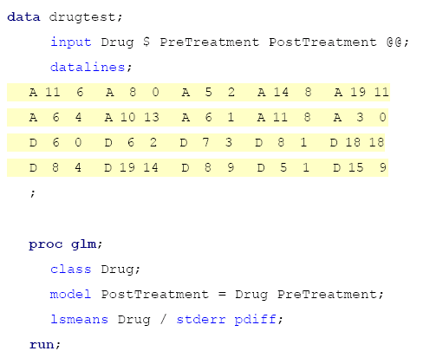
Result

Slide 88
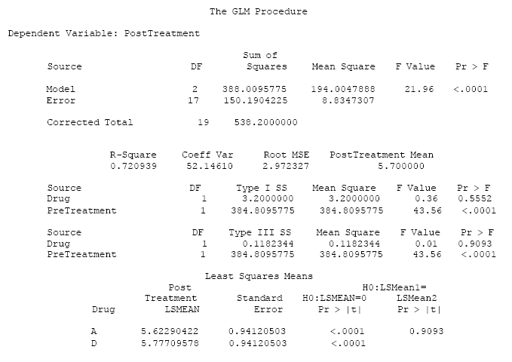
Result

Slide 89
Analysis Population
Intent To Treat (ITT) Set
Full Analysis Set
Per Protocol Set (PP)

Slide 90
Superiority
In superiority trials the full analysis set is used in the primary analysis because it tends to avoid over-optimistic estimates of efficacy resulting from a per protocol analysis, since the non-compliers included in the full analysis set will generally diminish the estimated treatment effect.

Slide 91
Equivalence/Non-inferiority
In an equivalence or non-inferiority trial use of the full analysis set is generally not conservative and its role should be considered very carefully.
Subjects who withdraw or dropout of the treatment group or the comparator group will tend to have a lack of response, and hence the results of using the full analysis set may be biased toward demonstrating equivalence.

Slide 92
Concept
Richard Peto指出ITT population分析只能用來找出不同，若找不出差異，並不代表兩種療法的效果一樣。
Richard Peto所提出之觀念乃應用於癌症或AIDS之臨床試驗，因該類型試驗在考量病人權益下，假設新療法用來和標準療法比較，在試驗期間病人對新療法無反應，就轉回標準療法，在此試驗設計下，若以ITT population評估一定期間(如二年)之存活率，應屬不適當。

Slide 93
SAS Output Delivery System

Slide 94
What Is the Output Delivery System?
Prior to Version 7, SAS procedures that produced printed output generated output that was designed for a traditional line-printer.
Beginning with Version 7, procedure output became much more flexible. The Output Delivery System (ODS) has been designed to overcome the limitations of traditional SAS output and to make it easy to make new formatting options available to users.
ODS is a method of delivering output in a variety of formats and of making the formatted output easy to access.

Slide 95
Basic Concepts of the ODS
In the past, the term "output" has generally referred to the outcome of a SAS procedure step. You could send this output to the Output window if you were working in a windowing environment, to an output device if you were working in line mode, or to a file if you used PROC PRINTTO or SAS system options.

Slide 96
ODS Destinations
ODS currently supports four destinations:
The Listing destination produces monospace output, which is formatted like traditional SAS procedure output. (ODS LISTING)
The HTML destination produces output that is formatted in Hypertext Markup Language. (ODS HTML)
The Printer destination produces output that is formatted for high-resolution printers. (ODS PRINTER)
The Output destination produces SAS data sets. (ODS OUTPUT)

Slide 97
Example – t test
PROC TTEST DATA=AH01;
VAR LABVALUE CHANGE;
BY VISIT;
RUN;

Slide 98
Output

Slide 99
ODS TRACE
ODS TRACE ON;
PROC TTEST DATA=AH01;
VAR LABVALUE CHANGE;
BY VISIT;
RUN;
ODS TRACE OFF;

Slide 100
LOG
Output Added:
-------------
Name: Statistics
Label: Statistics
Template: Stat.TTest.Statistics
Path: Ttest.ByGroup1.Statistics
-------------
Output Added:
-------------
Name: TTests
Label: T-Tests
Template: Stat.TTest.TTests
Path: Ttest.ByGroup1.TTests
-------------

Slide 101
Program
ODS LISTING CLOSE;
ODS OUTPUT STATISTICS=AS TTESTS=AT;
PROC TTEST DATA=AH01;
VAR LABVALUE CHANGE;
BY VISIT;
RUN;
ODS LISTING;

Slide 102
Contents (AS)

Slide 103
Contents (AT)

Slide 104
http://v8doc.sas.com/sashtml/

